Slide 1
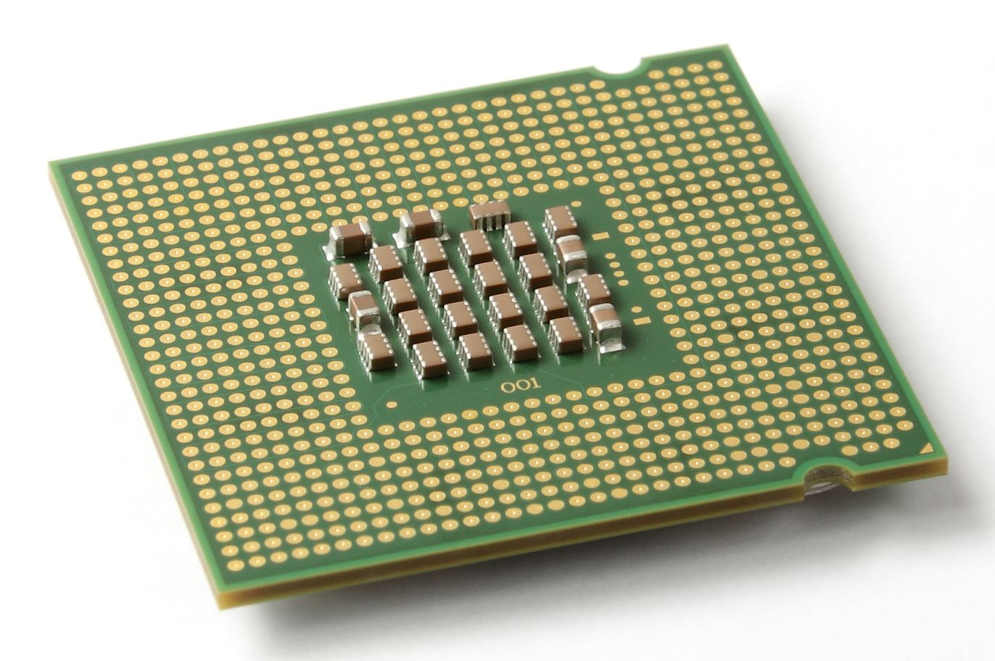
Von Neumann Architecture
and
Harward Architecture
Von Neumann architecture
Harvard architecture
Differences between Von Neumann and Harvard computer architectures
Advantages
Disadvantages
Presented by :-
-Shahrukh Padaniya
-Rohan Yadav
-Swapnil Sevak

Slide 2
Von Neumann Architecture
A von Neumann architecture was designed by physicist and mathematician John von Neumann.
It serves as the basis for almost all modern computers.
A von Neumann machine consists of a central processor with an arithmetic/logic unit and a control unit, a memory, mass storage, and input and output.
It is also known as IAS (Institute for Advanced Study) computer and is having three basic units:
The Central Processing Unit (CPU)
The Main Memory Unit
The Input / Output Device

Slide 3
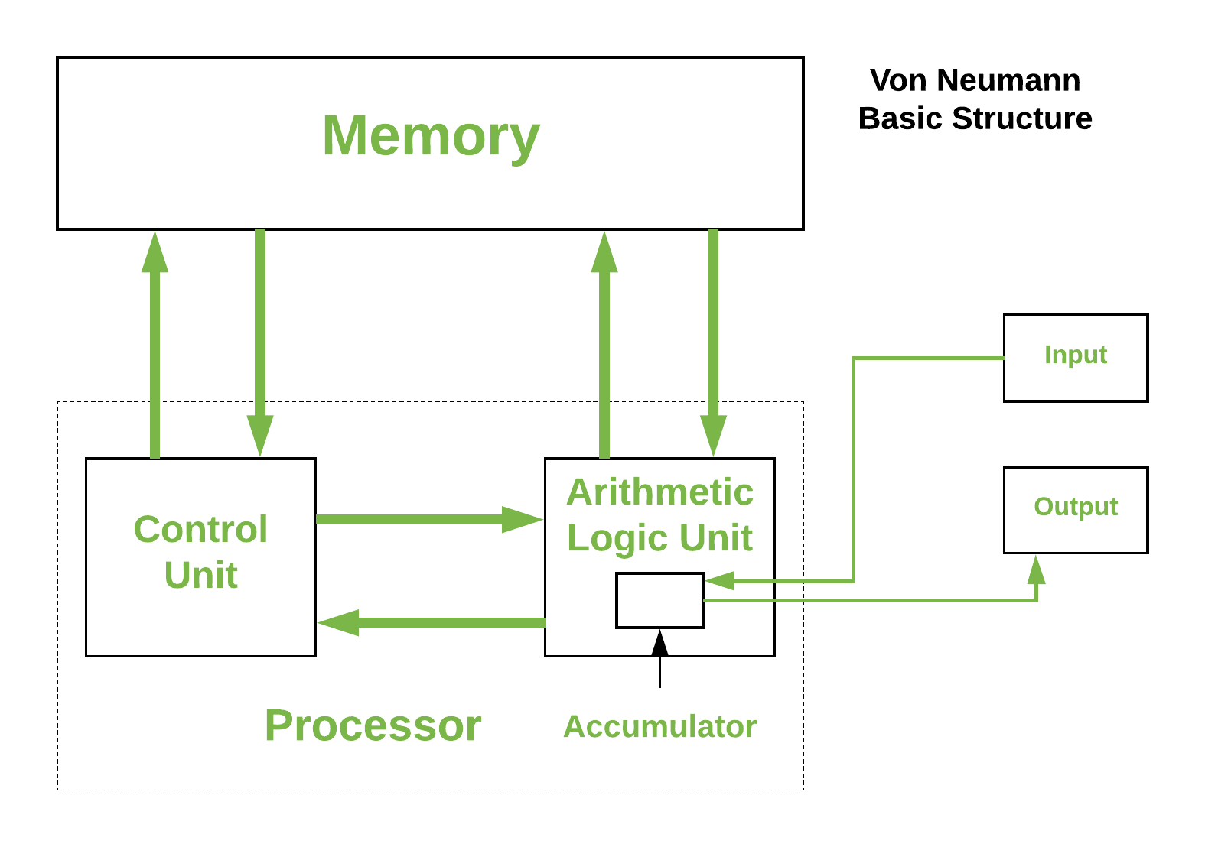
Figure 1: -

Slide 4
The CPU consist of 2 main parts: -
Control Unit –
A control unit (CU) handles all processor control signals.
It directs all input and output flow.
It fetches code for instructions and controlling how data moves around the system.
Arithmetic and Logic Unit (ALU) –
The arithmetic and logic unit is that part of the CPU that handles all the calculations the CPU may need, e.g. Addition, Subtraction, Comparisons.
It performs Logical Operations, Bit Shifting Operations, and Arithmetic Operation.

Slide 5
Main Memory Unit :- It contains both instructions and data.
The Memory Address Register (MAR) contains the address of the memory location currently in use.
The Memory Data Register (MDR) stores the data currently being transferred to and from memory.
Registers in memory unit:-
Accumulator: Stores the results of calculations made by ALU.
Program Counter (PC): Keeps track of the memory location of the next instructions to be dealt with. The PC then passes this next address to Memory Address Register (MAR).
Memory Address Register (MAR): It stores the memory locations of instructions that need to be fetched from memory or stored into memory.
Memory Data Register (MDR): It stores instructions fetched from memory or any data that is to be transferred to, and stored in, memory.
Current Instruction Register (CIR): It stores the most recently fetched instructions while it is waiting to be coded and executed.
Instruction Buffer Register (IBR): The instruction that is not to be executed immediately is placed in the instruction buffer register IBR.

Slide 6
Input/ Output Devices –
Program or data is read into main memory from the input device or secondary storage under the control of CPU input instruction.
Output devices are used to output the information from a computer.
Example-keyboards, pointers, card readers, displays, and printers.
Buses –
Data is transmitted from one part of a computer to another, connecting all major internal components to the CPU and memory, by the means of Buses.
Data Bus: It carries data among the memory unit, the I/O devices, and the processor.
Address Bus: It carries the address of data (not the actual data) between memory and processor.
Control Bus: It carries control commands from the CPU in order to control and coordinate all the activities within the computer.
There is only one data bus which is used for both instruction fetches and data transfer.
Data/instructions can pass in half duplex (scheduled/one at a time) mode.

Slide 7
Harvard Architecture
Harvard architecture is a type of computer architecture that separates its memory into two parts so data and instructions are stored separately.
The architecture also has separate buses for data transfers and instruction fetches. This allows the CPU to fetch data and instructions at the same time.
It gives better performance than Van Neumann Architecture.

Slide 8
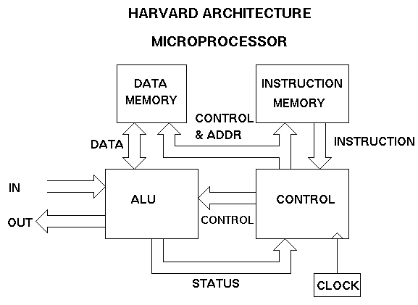
Figure: -2

Slide 9
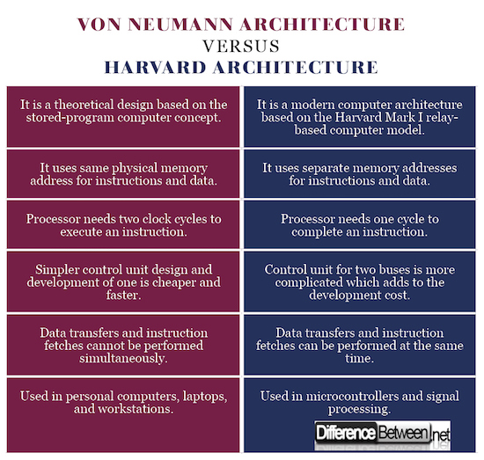
Differences between Von Neumann and Harvard computer architectures.
Von Neumann Architecture | Harvard Computer Architecture

Slide 10
Advantages
Von Neumann Architecture | Harvard Computer Architecture
Not only data but also instructions of programs are stored within the same memory. This makes it easier to re-program the memory. | There is less chance of corruption since data and instructions are transferred via different buses.
Data from memory and devices is accessed in the same way. | Since it has 2 separate memory, it allows simultaneous access to data and instructions.
The control unit gets data and instructions in the same way from one memory so the design and development of the control unit is cheaper and simplified. | Offers higher performance since Harvard allows for simultaneous fetching of data and instructions - they are kept in separate memory and travel via separate buses.

Slide 11
Disadvantages
Von Neumann Architecture | Harvard Computer Arthitecture
Has only one data bus shared for the transfer of data and instruction fetch; they must be scheduled because they cannot run simultaneously. | When there is free data memory it cannot be used for instructions and vice versa.
Does not support Pipelining. That is fetching of next data while execution of current data. | Production of a computer with two buses is more expensive and takes more time to manufacture.
Higher chance of corruption or error as the instructions and data are stored and transferred in the same way so may be accidently rewritten by bugs in programs

Slide 12

Whatever we do to enhance performance, we cannot get away from the fact that instructions can only be done one at a time and can only be carried out sequentially. Both of these factors hold back the competence of the CPU. This is commonly referred to as the ‘Von Neumann bottleneck’.
Drawbacks of Von Neumann Architecture

Slide 13

Any Questions?

Slide 14
References: -
http://gaintechknowledge.blogspot.com/2012/09/harvard-architecture.html
https://www.geeksforgeeks.org/computer-organization-von-neumann-architecture/
https://tdck.weebly.com/uploads/7/7/0/5/77052163/03_-_harvard_architecture_comparison.pdf

Slide 15

Thank You

